Slide 1


UNIVERSIDAD AUTÓNOMA DEL ESTADO DE HIDALGO
ESCUELA SUPERIOR DE ZIMAPÁN
Licenciatura en Derecho
Inglés VI.
L.E.L.I. Paulina Trujillo Castillo
Julio – Diciembre 2016

Slide 2
Resumen (Abstract)
When we are learning a foreign language it is really important to develop the language in the four skills. Reading is one of them and sometimes we are not able to know all the words in the articles or texts, so most students try to guess what the meaning is.
This is not wrong, in fact, it can be really helpful when students do proficiency tests.

Slide 3
Objetivo general:
El alumno hará énfasis del objeto del que se habla y no del sujeto que ejecuta la acción.
El alumno podrá expresar y solicitar opiniones e impresiones, podrá contar una historia con sus propias palabras así como sus intenciones, propósitos, expresar obligaciones y necesidades.

Slide 4
Nombre de la unidad:
UNIDAD 3: Crime
Objetivo de la unidad:
Al término de la unidad el alumno será capaz de hacer énfasis en las personas, cosas o lugares de las que se habla, asimismo al realizar preguntas.

Slide 5
Tema:
3.2 Identificar el significado de palabras en una lectura de acuerdo al contexto

Slide 6
Desarrollo del Tema:
Guessing meaning from context in proficiency exams is an important technique that will improve your reading skills and the speed with which you can read.
Obviously you do not have a dictionary in the exam so there are likely to be a lot of words from the reading text that you do not understand and you cannot check.
Therefore, guessing meaning from context is necessary.
This means work out what it means (or have a good guess at least) from the words that are around it and from the topic of the paragraph.

Slide 7

Here you have some suggestion to identify words in articles or texts.
1. Put yourself in context.
Words in English may have more than one meaning. If you put yourself in context you may guess easier what they are talking about.

Slide 8
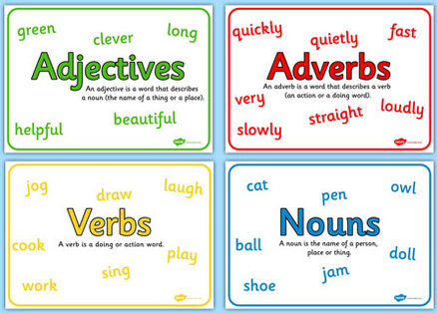
2. Identify the origin of the word.
How does the word is formed?
Is it a verb, a noun, adverb or an adjective?
They are questions which can be helpful to understand better.

Slide 9

3. Have prior knowledge of the world.
You should know about:
Synonyms and definitions.
Antonyms and contrast.
Cause and effect.
Parts of speech.
Examples.
General knowledge.

Slide 10
Conclusions
When you read, you may find many words you do not understand. It is not good to look up every new word in the dictionary. If you look up every word, your reading is interrupted.
In order to guess the meaning of some words the most useful thing it can be our prior knowledge of the world.

Slide 11
Referencias:
Paul Davies, M. G. (2014). Make it Real! Professional. Mexico: Universidad Autónoma del Estado Hidalgo.
My English Pages. (17 de August de 2016). Obtenido de http://www.myenglishpages.com/blog/guessing-meaning-from-context/
Robinson, J. (2010). www.douglascollege.ca. Obtenido de https://www.douglascollege.ca/~/media/6C078C8CD75945C89A4CBB12F6A1A670.ashx?la=en

